Slide 1
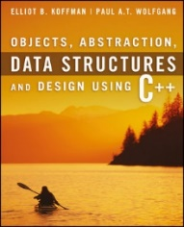
Welcome to
CS 235 Data Structures
C++ Primer, P.4-6 (04)

Slide 2
Tip #04: Chunking
A primary method that the brain uses to help it absorb more information is called 'chunking'.
One chunk is a recognizable piece of information that be fitted into one of the 'slots' in short-term memory.
Chunking makes block structured languages like C/C++ natural to use.
The program is a single chunk, which is divided and subdivided into smaller and smaller chunks.
Each chunk is visibly and logically distinguishable.
Lay out code in chunks
Groups of statements which together perform an identifiable act, should be chunked.
Items which are close together form a visual chunk and have an implied association.
Vertical white space (form feeds and blank lines) can be used not only to separate chunks but also to show relationships between chunks.
By recognizing chunks and making them stand out, code can be made more readable which means more maintainable.
Un-chunked List:
Bread
Ice cream
Milk
Tomatoes
Eggs
Butter
Apples
English muffins
Frozen vegetables
Lettuce
Cream
Bananas
Chunked List:
Frozen Foods Bakery
Ice cream Bread
Frozen vegetables Bagels
Dairy Fruits / Vegetables
Milk Tomatoes
Eggs Apples
Butter Lettuce
Cream Bananas
Notes:
Consider newspapers and magazines articles. The heading is big and visible. The article itself tends to be fairly brief. Paragraphs are small. If the article is more than a few lines long, it is broken up with sub headings, out-of-context quotes, pictures, etc. It is delimited with blank and solid lines. Everything possible is done to break it up and give the brain time to stop and take in each piece of the message.

Slide 3
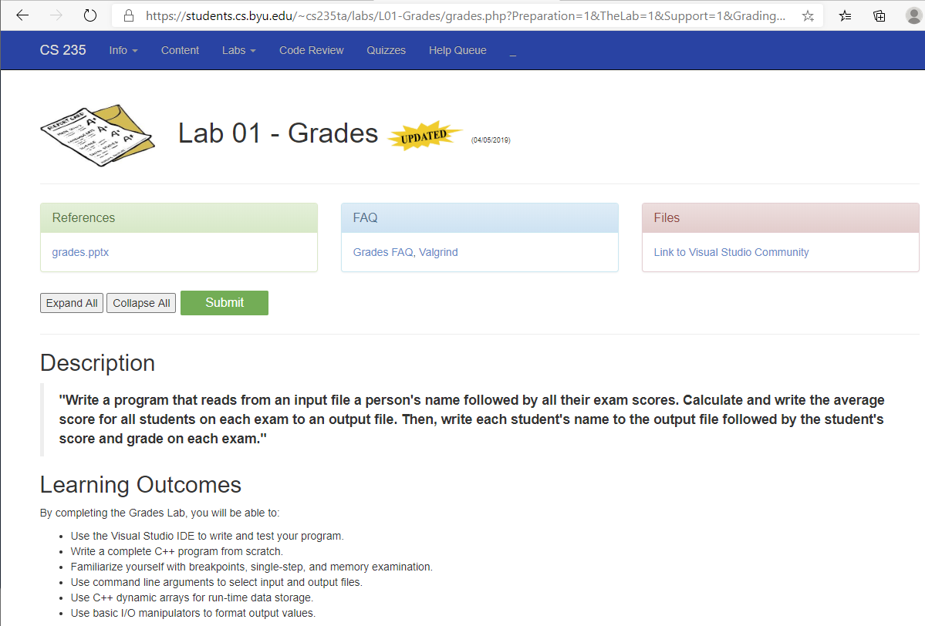

Slide 4
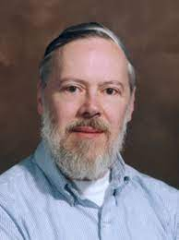
15 Minute Crash Course in C++
Dennis Ritchie (1940-2011)
Ritchie developed C between 1969 and 1973 for use in writing compilers and operating systems (UNIX).
C is a low-level, high-level language and one of the most popular programming languages of all time – very few computer architectures exist for which there is no C.
Bjarne Stroustrup (1950 - )
Stroustrup developed C++ (initially called "C with Classes") between 1979 and 1985 to extend C for object-oriented programming, resource management (RAII), inheritance, and polymorphism.
Support for efficient object-oriented programming with constructors, destructors, exceptions copying, movement of objects, and operator overloading based on virtual function tables.
Later support was added for template metaprogramming with specialization and compile-time evaluated functions.

Slide 5
What is C++?
C++ is an object-oriented programming language that associate classes and objects with attributes and methods.
For example: in real life, a car is an object. The car has attributes, such as weight and color, and methods, such as drive and brake.
Statements are the smallest independent unit of computation and most (but not all) statements end in a semicolon.
Variables are symbolic names (labels) for memory locations that are defined either as local (automatic) – declared within a function and allocated on stack at run-time or global (static) – declared outside a function and allocated at compile time.
Operators are symbols that perform operations on values and variables and have precedence and associativity and can be overridden.
Expressions are formed by combining variables with operators that evaluate to a single value.
Functions are expressions consisting of a group of statements.

Slide 6
Compiling a C++ Program
C/C++ Code
Source Files
#include <iostream>
int main()
{
std::cout << "Hello, world!\n";
}
Preprocessor
Translation Units
Code Generator
Compiler
Replace symbol with code everywhere it appears in the program:
#define MAX_LENGTH 80
#define PI 3.14159
Replace directive itself with the contents of header file:
#include <stdio.h> // system file
#include "myheader.h" // user file
Assembler Code
Assembly Code
Library-build
Process
Assembler
Object Code
Object Files
Object Files
Linker
Linker
Machine Code
Machine Code
Object File
Executable
Object File
Executable

Slide 7
Terms…
Activation Record – A block of memory on the stack that is created when a function is called and contains all the local variables for a given invocation of a function.
Arithmetic Operator – Operator that returns a numerical value.
Associativity – The execution order of same precedence operators.
Bitwise Operator – Operator that performs bitwise logical operations.
Data type – Representation and valid operations of data object.
Expression – Combination of variables / operators that returns a single value.
Global (static) – Variable permanently assigned to a memory location.
Literal – An immutable data object.
Local (automatic) – Variable stored in a functions activation record.
Logical Operator – Operator that returns a logical (true/false) value.
Operator – Performs an operation on operand(s).
Scope - Extent of a variable/function’s availability in a program.
Precedence – The execution order of operators.
Variable - Symbolic name for a memory location that hold a value.
Variable Coercion – Forcing mixed data type variables to a common type.
Volatile – Variable modifier that prohibits optiminization by compiler.

Slide 8
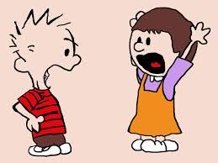
Main Function Arguments

Slide 9
Argc and argv
#include <iostream>
#include <fstream>
#include <string>
using namespace std;
int main(int argc, char* argv[])
{
if (argc < 2) return 3;
ifstream in(argv[1]);
if (!in) return 1;
ostream& out = (argc > 2) ? *(new ofstream(argv[2])) : cout;
if (!out) return 2;
string line;
while (in >> line)
{
out << line << endl;
}
if (&out != &cout) delete(&out);
in.close();
return 0;
}
argc:
3
p | r | o | g | r | a | m | . | e | x | e | ∅
argv:
i | n | . | t | x | t | ∅
∅
o | u | t | . | t | x | t | ∅
Open argv[1] for input.
Open argv[2] for output if argc > 2,
else use cout for output.
>>program.exe in.txt out.txt
argv[0]
argv[1]
argv[2]

Slide 10
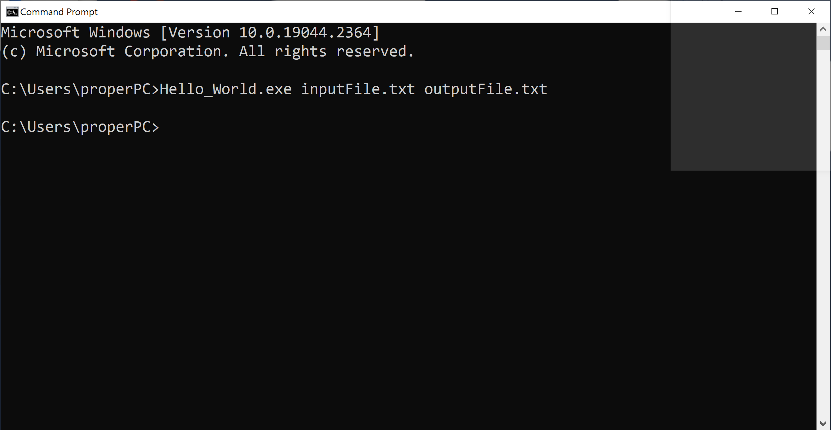
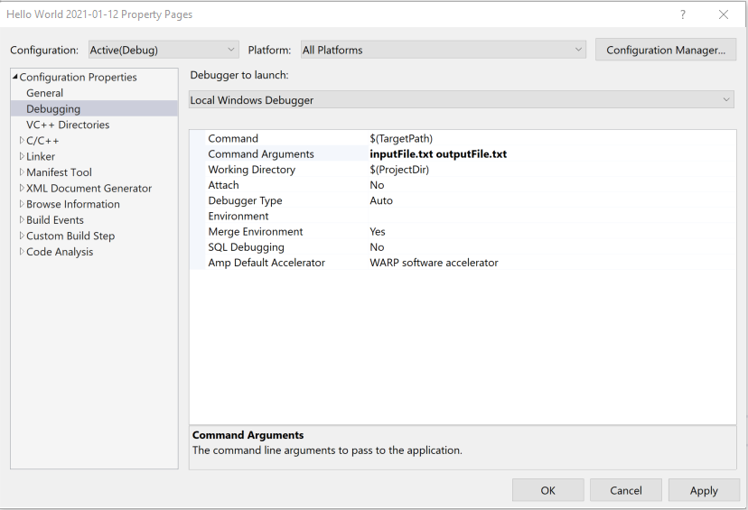
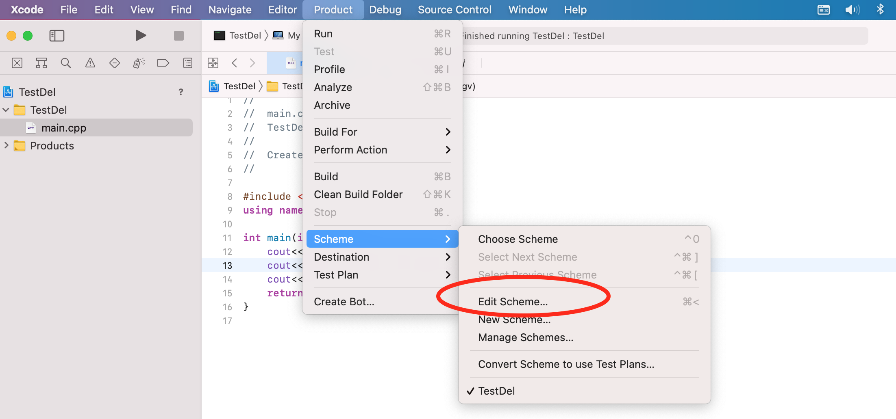
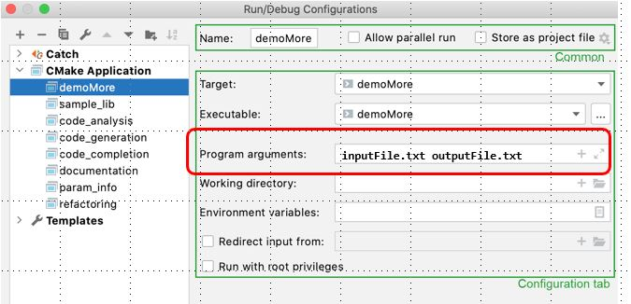
Argc and argv
CLion
XCode
Visual Studio
Command Prompt

Slide 11
P.4 Primitive Data Types and Class Types
Primitive Data Types
Primitive-Type Variables
Operators
Postfix and Prefix Increment
Type Compatibility and Conversion
P.5 Objects, Pointers, and References
Object Lifetimes
Pointers
The Null Pointer
Dynamically Created Objects
References
P.6 Functions
Function Declarations
Call by Value Versus Call by Reference
Operator Functions
Class Member Functions and Implicit Parameters
04 – Cpp Primer

Slide 12
C++ Translation Units
A translation unit is the basic unit of compilation in C++.
It consists of the contents of a single source file, plus the contents of any header files directly or indirectly included by it, minus those lines that were ignored using conditional preprocessing statements.
A single translation unit can be compiled into an object file, library, or executable program.
Objects have shared access across multiple translation units as follows:
Non-statically-scoped objects (like classes or functions) are shared across multiple translation units.
The keyword static limits scope to the translation unit.
Global variables can be shared via the extern keyword.

Slide 13
C++ Data Types
An object is fundamentally an area of the computer’s memory containing data of some kind (data type).
How the object is stored
What operations are legal on the object.
C++ Data Types
Primitive Data Types
User Defined Types
Derived Types
struct
class
union
enum
(array)
typedef
function
pointer
reference
Integral Types
Floating Types
void
char
short
int
long
bool
wchar_t
float
double
long double

Slide 14
Operator Precedence/Associativity
OPERATORS | ASSOCIATIVITY
( ) [ ] -> . | left to right
! ~ ++ -- + - * & (type) sizeof | right to left
* / % | left to right
+ - | left to right
<< >> | left to right
< <= > >= | left to right
== != | left to right
& | left to right
^ | left to right
| | left to right
&& | left to right
|| | left to right
?: | right to left
= += -= *= /= %= &= ^= |= <<= >>= | right to left
, | left to right
Unary operators associate right to left.

Slide 15
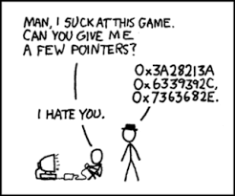
P.5 Objects, Pointers, and References
Object Lifetimes
Pointers
The Null Pointer
Dynamically Created Objects
References
P.5 Objects, Pointers, and References

Slide 16
Pointers
A pointer is a memory address.
With pointers
functions can indirectly access variables.
functions can modify the arguments passed by the caller function.
sophisticated data structures can grow and shrink at run-time.
Arrays and pointers are closely related.
Array pointers enable us to process groups of data such as vectors, lists, and strings.
A pointer variable contains a memory address.
Associated with a pointer variable is the type of value to which it points.
The asterisk (*) indicates that the following identifier is a pointer variable.
The ampersand (&) returns a pointer (address) to the following identifier.
int var = 10;
10
20
var:
30
int *ptr = &var;
*ptr = 20;
ptr:
int **p_ptr = &ptr;
**p_ptr = 30;
p_ptr:

Slide 17
Dynamic Objects
When any C++ object is created
Storage must be allocated for the object (static, stack, or heap).
The constructor is called to initialize that storage.
The destructor is called to release object storage.
Stack
Dynamic Data (Heap)
Static data (global variables)
Program Code
With local objects, the compiler decides
where the object is stored (stack),
when the object is constructed (declaration), and
when the object is destroyed (goes out of scope).
With dynamic objects, the programmer decides
where the object is stored (heap),
when the object is constructed (new operator), and
when the object is destroyed (delete operator).
Pointers are always used to refer to dynamically created objects.
{
int size = 4;
int* myInts = new int[size];
}
size:
4
myInts:
size

Slide 18
P.6 Functions
Function Declarations
Call by Value
Call by Reference
Operator Functions
Class Member Functions and Implicit Parameters
P.6 Functions

Slide 19
Call by Value
#include <iostream>
using std::cout;
void swap(int x, int y)
{
int temp = x;
x = y;
y = temp;
}
int main()
{
int a = 10;
int b = 20;
swap(a, b);
cout << "a = " << a << endl;
cout << "b = " << b << endl;
return 0;
}
Function name
Stack
return
a 10
Activation
record
b 20
Function parameters
return
Function return type
x 10
-- 20
Activation
record
y 20
-- 10
Function arguments
temp --
-- 10
Call by value means a copy of a function's argument object is passed to the function.

Slide 20
Pointers vs References
Pointers and references use one variable to access another variable.
A pointer variable holds the memory address of another variable.
A pointer variable is dereferenced (access to the memory location pointed to) with the "*" operator.
A reference variable is an alias, that is, another name for an already existing variable.
A reference, like a pointer is also implemented by storing the address of an object.
A reference can be thought of as a constant pointer with automatic indirection (the compiler will apply the * operator for you).
A variable is declared as reference by putting ‘&’ between the reference type and the variable name in the declaration.
int a;
int b;
ptr_a:
✗
ref_a:
int *ptr_a = &a;
ptr_a = &b;
int &ref_a = a;
✗
b:
a:
ref_a = b;

Slide 21
Pointers vs References
void swap(int* x, int* y)
{
int temp = *x;
*x = *y;
*y = temp;
}
int main()
{
int a = 10;
int b = 20;
swap(&a, &b);
cout << "a = " << a << endl;
cout << "b = " << b << endl;
return 0;
}
void swap(int& x, int& y)
{
int temp = x;
x = y;
y = temp;
}
int main()
{
int a = 10;
int b = 20;
swap(a, b);
cout << "a = " << a << endl;
cout << "b = " << b << endl;
return 0;
}

Slide 22
Call by Reference
#include <iostream>
using std::cout;
void swap(int& x, int& y)
{
int temp = x;
x = y;
y = temp;
}
int main()
{
int a = 10;
int b = 20;
swap(a, b);
cout << "a = " << a << endl;
cout << "b = " << b << endl;
return 0;
}
Stack
return
a 10
-- 20
b 20
-- 10
return
&x
&y
temp --
-- 10
Call by reference means a reference (implied pointer) to the argument object is passed to the function.

Slide 23
References vs Pointers
Similarities
Both references and pointers can be used to change the values of function parameters.
Both can save your program from making a copy of a big object that is passed as an argument to a function or returned from a function.
Differences
A reference variable must be initialized when declared and cannot be changed to a reference another object (cannot be reseated) – not very useful!
You can not take the address of a reference.
You can not create an array of references or declare a reference to a reference.
References cannot be void or NULL. (Pointers are often made NULL to indicate that they are not pointing to any valid thing.)
Hence,
Pointers are more flexible.
Reference variables are safer (no wild pointers) and easier to use.

Slide 24
Call by Constant Reference
Call by Value
The function argument can be an object or an expression.
A copy of the argument is pushed on the stack and becomes a local function parameter variable.
Any changes to the function parameter will not be reflected in the actual function argument.
Call by Reference
The function argument can only be an object (not an expression.)
The function parameter becomes a reference (pointer) to the actual argument.
Any changes to the formal function parameter will be reflected in the actual argument.
Call by Constant Reference
While it is more efficient to call by reference, the caller may not want the value of the argument to be changed.
A function can guarantee that argument will not be changed by declaring the parameter to be a constant reference.
int countFrequency(char c, const string& s);

Slide 25
Operator Functions
C++ allows us to define class types that behave as if they were primitive types by overloading class operators.
Operator overloading is resolved by signature.
Can't invent operators (e.g., ** for exponentiation.)
Must have same number of arguments as built-in types (except for operator() ).
Some operators are off limits (".", "?:", sizeof, and "::")
+ -
* /
% ^
& |
~ !
= <
> ,
+= -=
*= /=
%= ^= &= |=
<< >>
>>= <<=
== !=
<= >= && ||
++ --
->* ->
( ) [ ]
Return Data Type
Reserved Keyword
1st Operand (*this)
2nd Operand (&myClass)
int myClass::operator++();
bool myClass::operator==(const myClass&) const;
string operator+(const string&, const string&);
Class Name
myClass operator++
(unary pre-increment)

Slide 26
Be Safe

